Slide 1




Feature Engineering
Crafting Better Signals for Machine Learning
Presented by: Dr Grace U. Nneji
Dr Happy N. Monday

Slide 2


Learning Objectives
After completing this lecture, you will be able to:
Define key FE terms (feature, target, encoding, scaling, interaction, etc.).
Convert raw data types into model-ready numerical formats.
Engineer cyclical time features (sine/cosine) for temporal tasks.
Scale, normalize, and transform numerical variables.
Create interaction and aggregate features using domain knowledge.
Export a production ready features.csv file.
Evaluate feature quality with exploratory plots and correlation metrics.
Design practical exercises and exam-style questions for self-assessment.
2

Slide 3

This is the art and science of transforming raw data into meaningful representations features that unlock predictive power for machine learning (ML) algorithms.
FEATURE ENGINEERING
A well-engineered feature set can turn a mediocre model into a state of the art performer, while poor features can cripple even the most sophisticated algorithm.
3

Slide 4
KEY TERMINOLOGY AND DEFINITIONS
Term | Definition
Feature | A single measurable property used as input to an ML model
Target / Label | The variable the model is trained to predict.
Encoding | Converting categorical or cyclical data into numerical form.
Scaling | Transforming a feature’s range (e.g., 0?1) to stabilise gradients and speed up training.
Normalization | Rescaling data to unit norm (L2 = 1) or 0?1 range.
Standardisation | Transforming a feature to zero mean and unit variance.
Interaction Feature | A new variable created by combining two or more existing features (e.g., Voltage × Current).

Slide 5

We start from the cleaned DataFrame produced in Chapter 2
import pandas as pd
df = pd.read_csv('data/household_power_consumption_cleaned.csv',
parse_dates=['datetime'])
LOADING & INITIAL CLEANING
Ensure numeric dtypes:
numeric_cols = ['Global_active_power','Global_reactive_power','Voltage',
'Global_intensity','Sub_metering_1','Sub_metering_2','Sub_metering_3']
df[numeric_cols] = df[numeric_cols].astype(float)
5

Slide 6
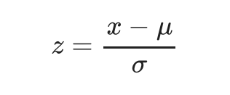
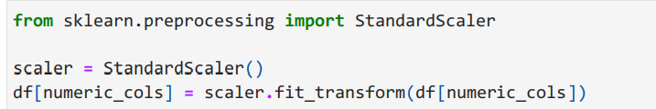
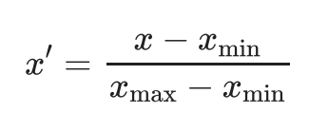
Scaling adjusts feature values to a standard range, improving model performance and convergence speed.
Normalization transforms features to maintain consistency, ensuring that each feature contributes equally to the analysis.
SCALING AND NORMALIZATION TECHNIQUES
Standardisation (Z-score)
Min-Max Scaling
6

Slide 7


Domain-driven features leverage expert knowledge to create meaningful inputs, improving model interpretability and effectiveness.
Interaction features can significantly enhance model performance by capturing complex relationships between variables.
INTERACTION AND DOMAIN-DRIVEN FEATURES
For example, electrical apparent power (S) (kVA):
Example 2, Power Factor, PF
7

Slide 8

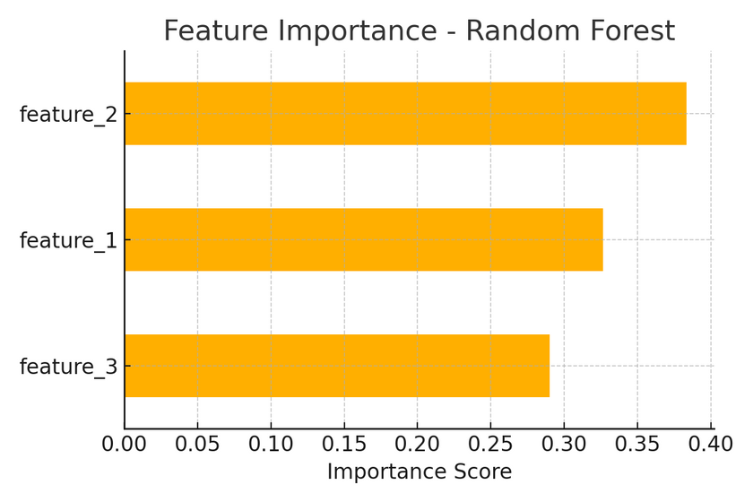
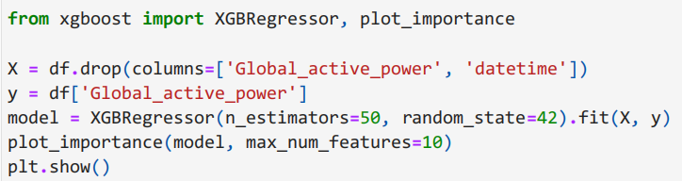
FEATURES IMPORTANCE INSIGHTS IN ML
Feature Importance Insights
Feature importance bar charts clearly highlight which features drive model predictions effectively.
8

Slide 9

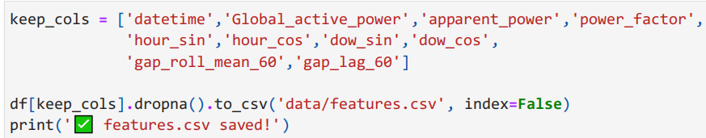
To ensure model reproducibility, we must persist the feature matrix to a file format that is easily accessible.
SAVING THE FEATURE MATRIX IN ML
Common formats include CSV or binary files, allowing for efficient data retrieval in future analyses or model training.
9

Slide 10

Hands-on practice is essential for mastering feature engineering and applying machine learning concepts effectively in real-world scenarios.
10

Slide 11



In this lecture, we've explored the critical techniques of feature engineering, emphasizing its role in enhancing model performance and providing practical strategies to apply these concepts in your ML projects.
KEY TAKEAWAYS
11

